Slide 1

Linkedin Job Analysis
Linkedin Job Analysis
Team Members
Sumit Singh Rajpoot
Mayank Porwal
Amit BJ
Monu Kumar
Laraib Ahmed
Team Members
Sumit Singh Rajpoot
Mayank Porwal
Monu Kumar
Amit BJ
Laraib Ahmed

Slide 2

Objectives of Our Project
Analyzing distribution of jobs in India
One can get Most common experience level, most common industry, most common class, no. of jobs based on SKILL’s searched through a web page.

Slide 3
Key Insights

Slide 4
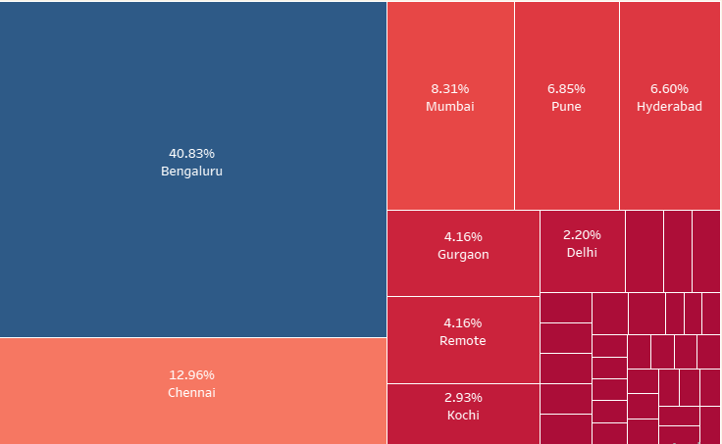
TOP Cities
40% of the jobs posted on LinkedIn have location Bengaluru.
Top 5 cities have 75%+ job posting of the total job postings and majority of them are from south India.

Slide 5
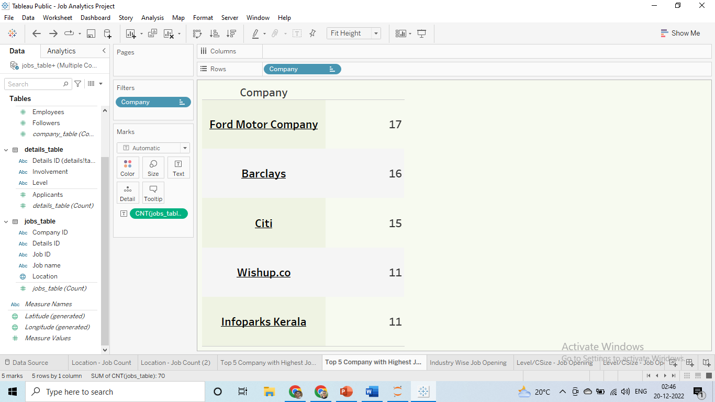





Top 5 Big companies (in terms of job openings on LinkedIn)
Job Openings

Slide 6
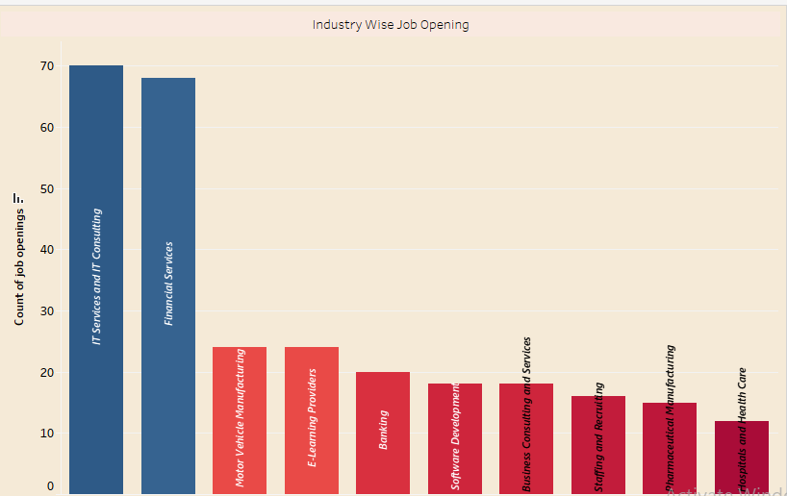
Top 10 Sectors
Most number of job openings are in ‘IT services and consulting’ industry (i.e. 70/409) around 17.1%. While ‘Financial Services’ comes at 2nd position with 68 job openings.

Slide 7
Let’s Explore Interactive Dashboard for some more Insights.

Slide 8
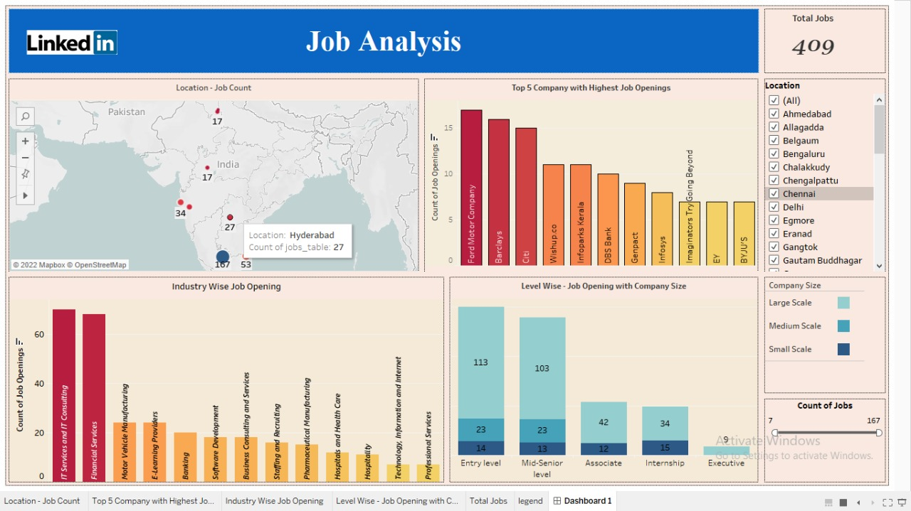
Dashboard

Slide 9
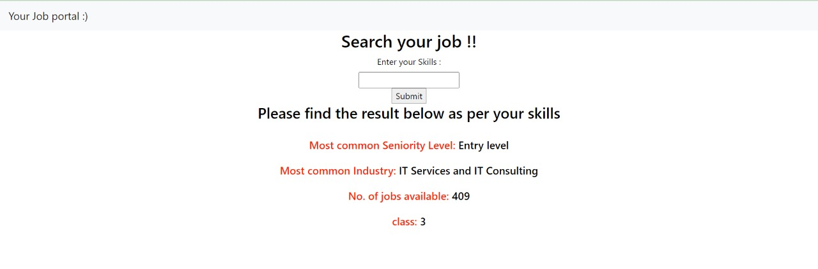
Snap-Shot of Web Page (search for job based on skills)

Slide 10
Learnings
WEB SCRAPING: Working knowledge of Python Packages like Selenium, Beautiful Soup Lib, and how to do web scraping.
01
Use Tableau for Data Visualization
And finding Key Insights
02
How to make Data models, and web pages & explore HTML, CSS, and Flask API For Deployment
03
Use of ML model to Practical Data
Tackling more complex problems
Time management, Teamwork
04

Slide 11

Any Questions & Suggestions?

